Slide 1

TILLY TRADERS Balance Day Adjustments - Solution
Year 11 Accounting & Finance
This Photo by Unknown Author is licensed under CC BY-SA-NC

Slide 2
Workings:
Prepaid rent on trial balance– prepaid rent on balance day = rent expense
= $48 000 – $12 000 = $36 000
Electricity expense at balance day amount – electricity expense in trial balance = electricity expense
= $2 800 – $2 550 = $250
Office supplies on trial balance – office supplies at balance day = office supply expense
= $7 000 – $900 = $6 100
Accrued Wages:
Accrued wages was $7 000 on balance day

Slide 3
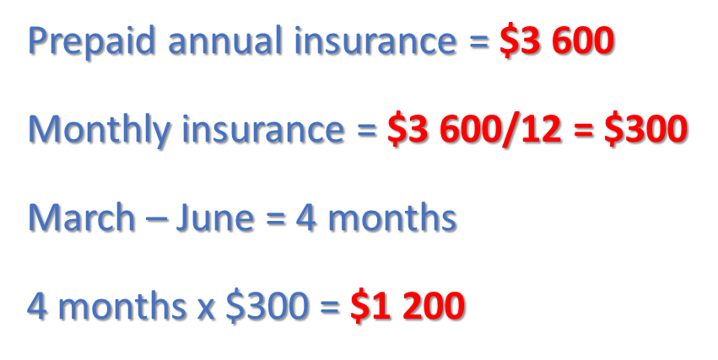
Workings Continued:

Slide 5
Tilly’s General Journal Continued

Slide 6
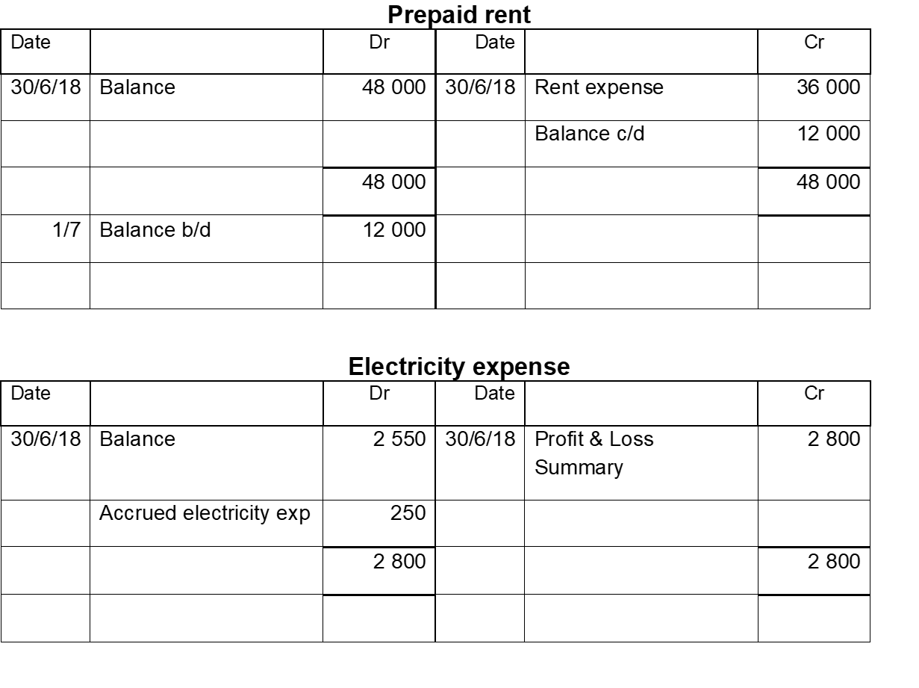

Slide 7


Slide 9


Slide 11
2 400
2 400
15 300

